Slide 1
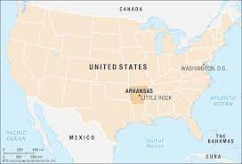
Benjamin Beardsley 3/23/22
Epperson v Arkansas

Slide 2
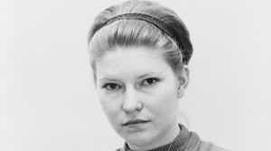
Date of the case
The date of the case was October 16th 1968.

Slide 3
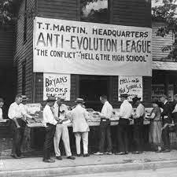
Case Background Information
Where Epperson was accused of breaking a 1928 law by the scopes trial. The case was brought into the Warren Court. Where later on found Guilty of breaking the First Amendment established Clause.

Slide 4
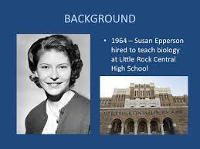
Main case facts
The school board of the school on which Epperson was teaching was threating her to teach out of a new book or other wise she will be fired. But guess what people she was Fired. (SURPRISE!). But anyways she was arrested later on found guilty and had to go to the supreme court.

Slide 5
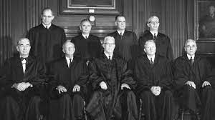
Outcome of the case
On November 12th , 1968 in the supreme court the judges (9-0) was later on found her non – guilty of the crimes. And gave her the right to go back to teaching.

Slide 6
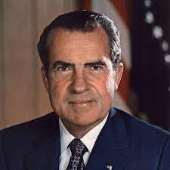
Summary.
Epperson v. Arkansas is significant because it demanded governments refuse to favor any particular religion or religious theory over another. Governments must maintain a religious neutrality, the Supreme Court said in Epperson.

Slide 7
Internet addresses.
https://www.oyez.org/cases/1968/7
Google.com

